Slide 1

Common Components
Check this box to force users to type password each time Recommended on shared computers

Slide 2
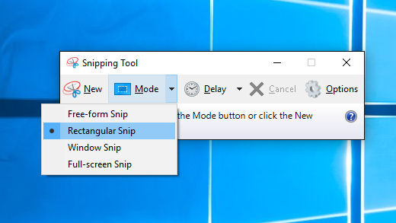
Screenshot tips
If using windows, the ‘snipping tool’ has ‘window mode’ to take a snip of a specific software window
Simply open snipping tool, then the window you want (including any menu nav), click ctrl+PrtScn and select the window

Slide 3
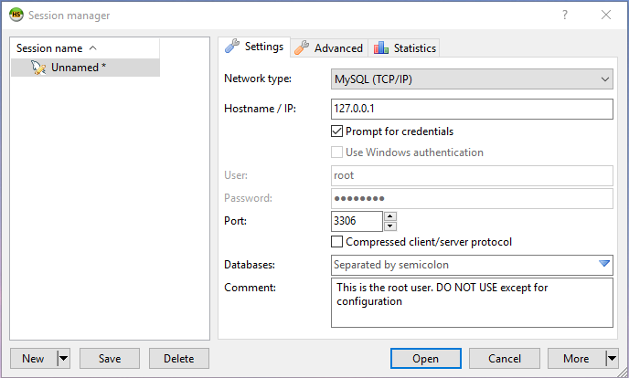
Check this box to force users to type password each time Recommended on shared computers

Slide 4
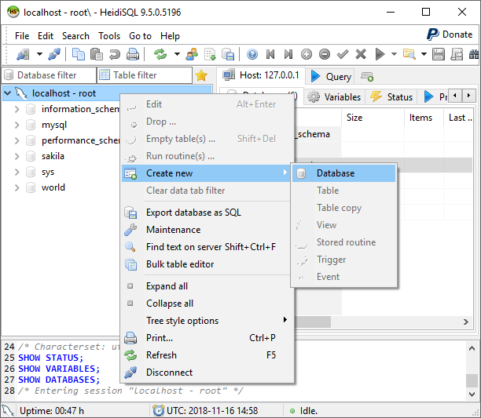
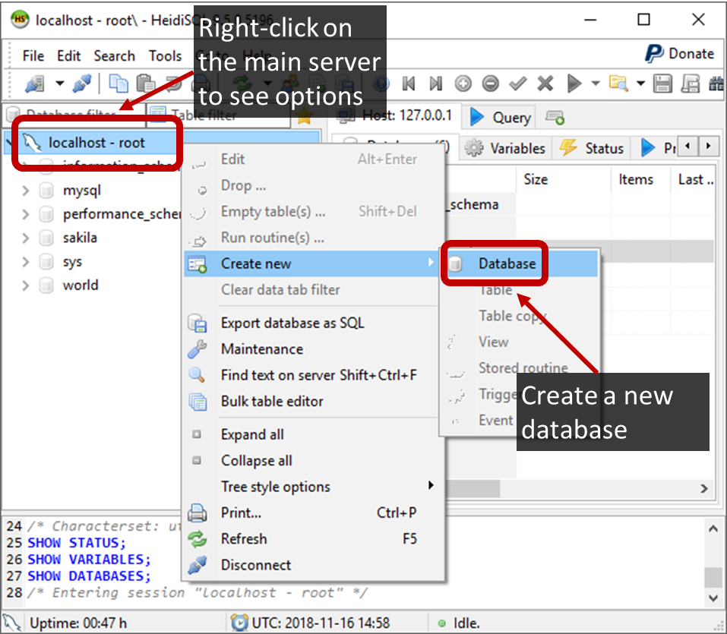
Right-click on the main server to see options
Create a new database

Slide 5
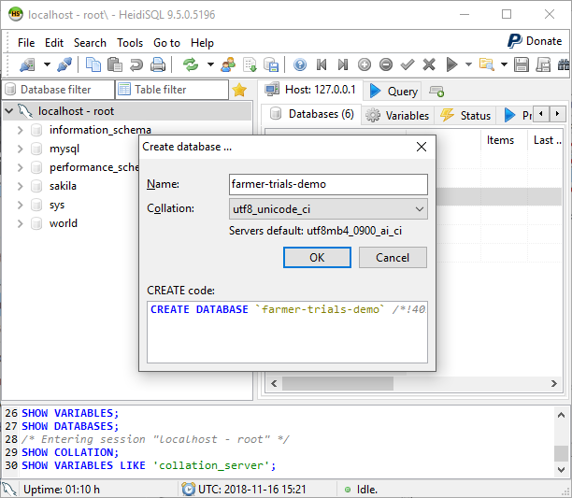
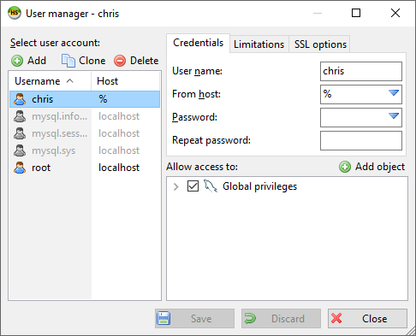
Users you have created appear here
Make sure you set the correct format here

Slide 6
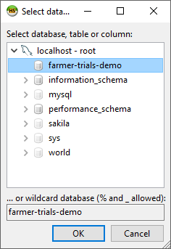
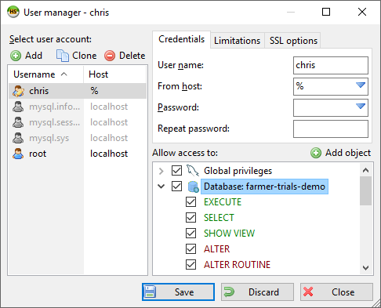
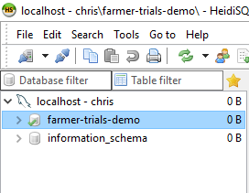
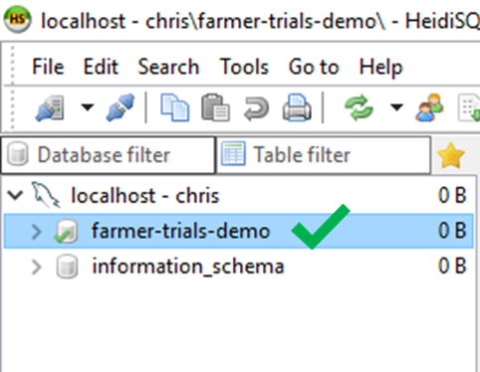
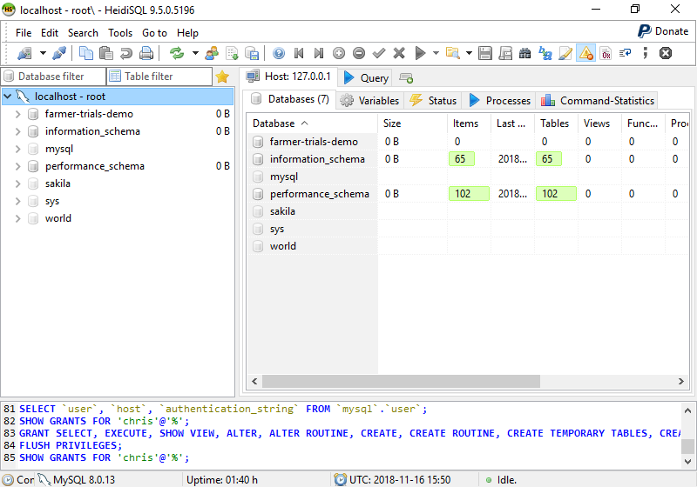
Tick this box to grant all priviledges

Slide 7
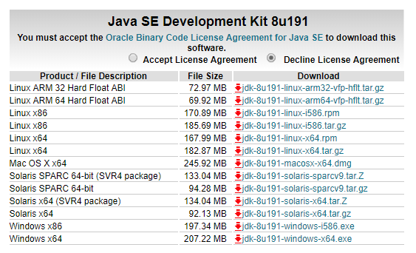
You will need to tick this box also
Windows installers

Slide 8
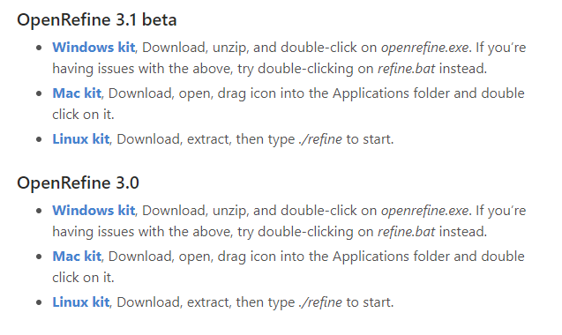
Do not download ‘beta’ versions as they might contain bugs
This version will be better

Slide 9
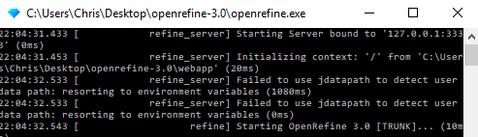

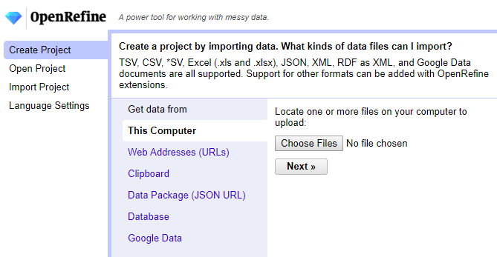

Slide 10
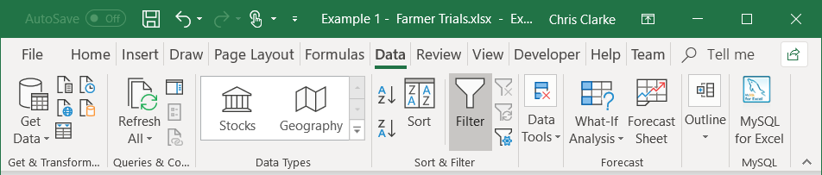
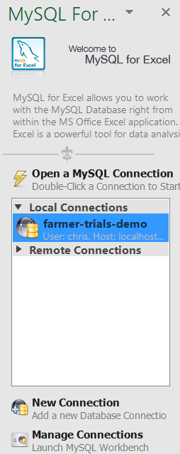
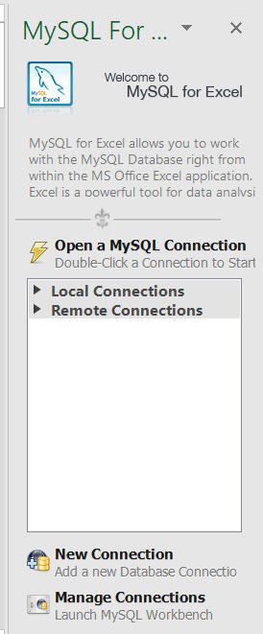
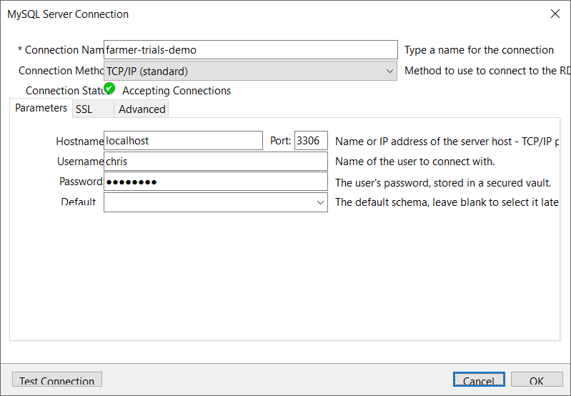
You will see this button if MySQL for Excel is installed

Slide 11
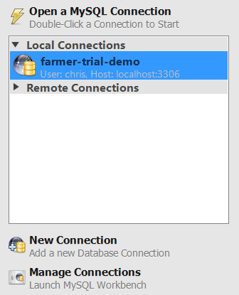
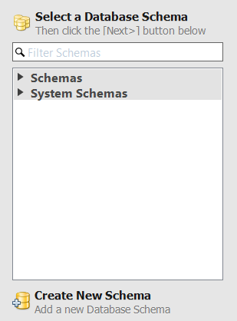
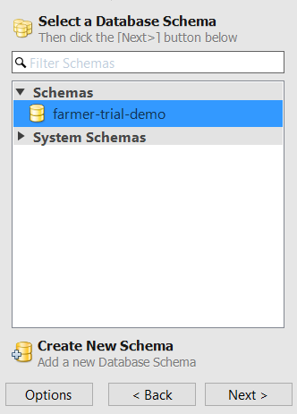
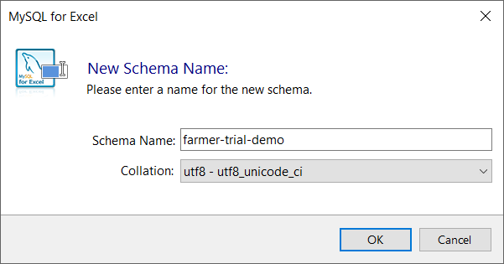
Change this to utf8_Unicode_ci

Slide 12
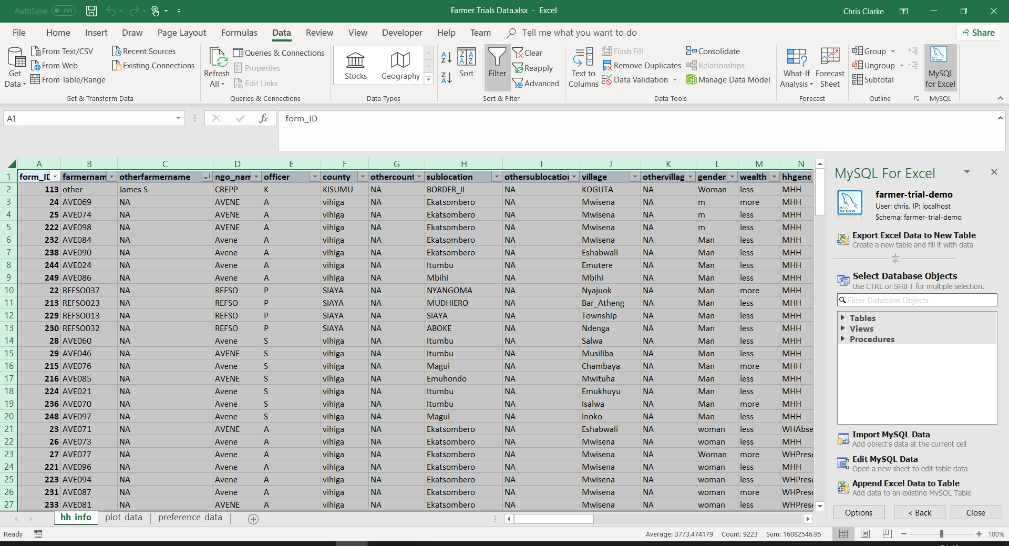
You can click here to select all data

Slide 13
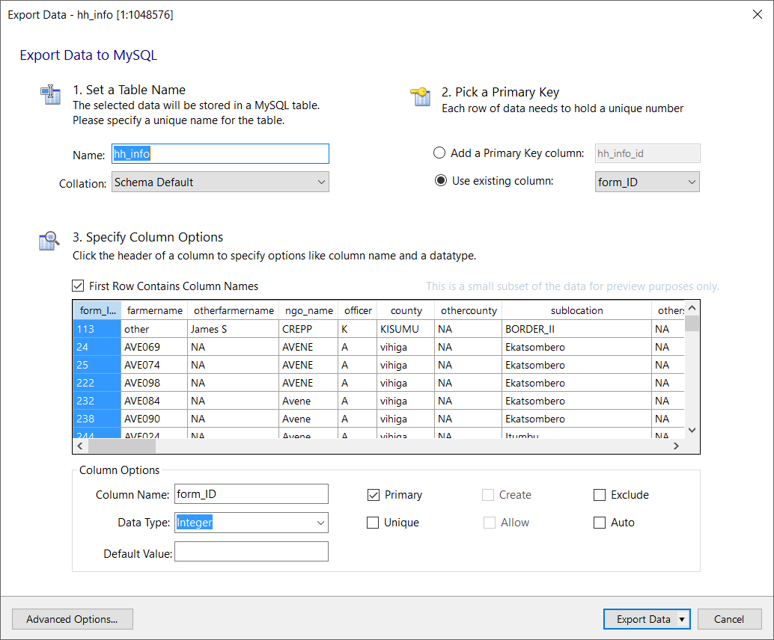
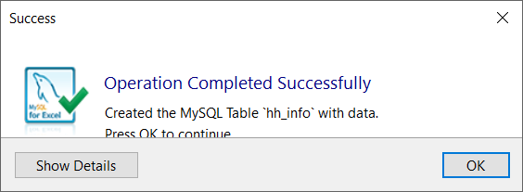

Slide 14
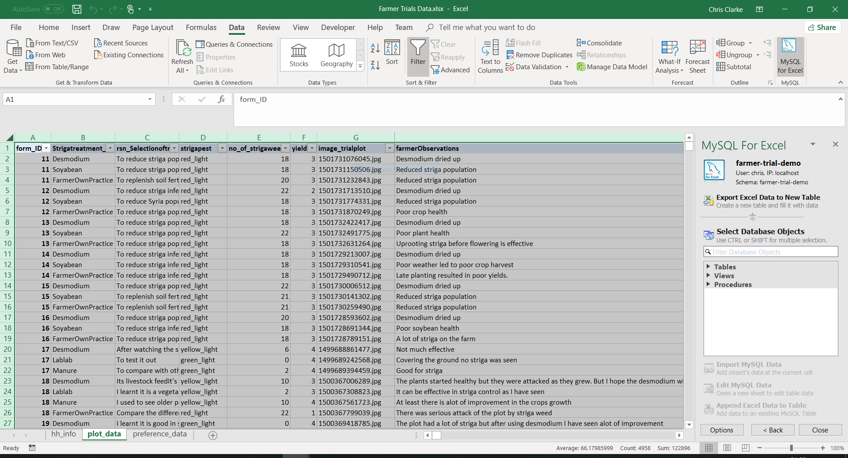

Slide 15
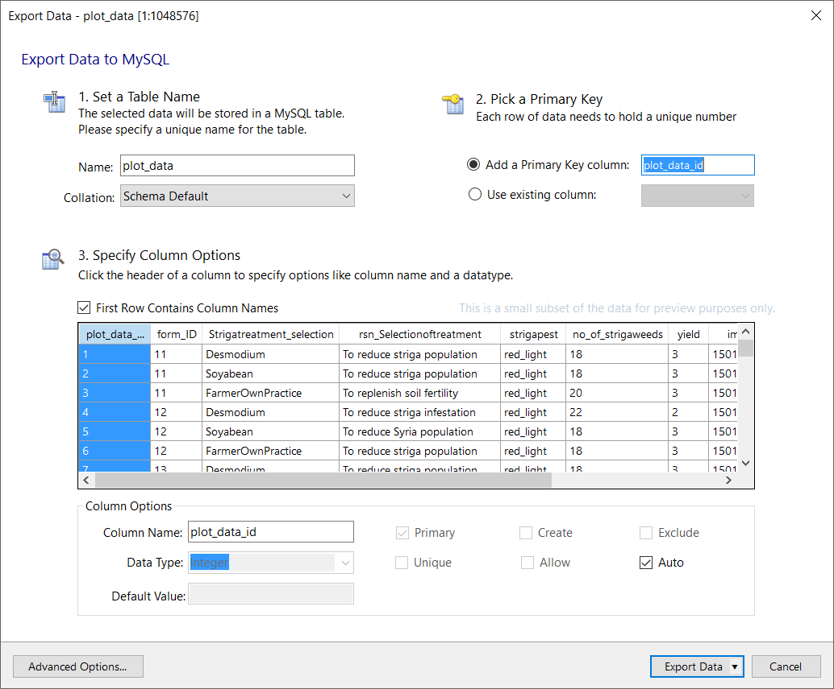

Slide 16
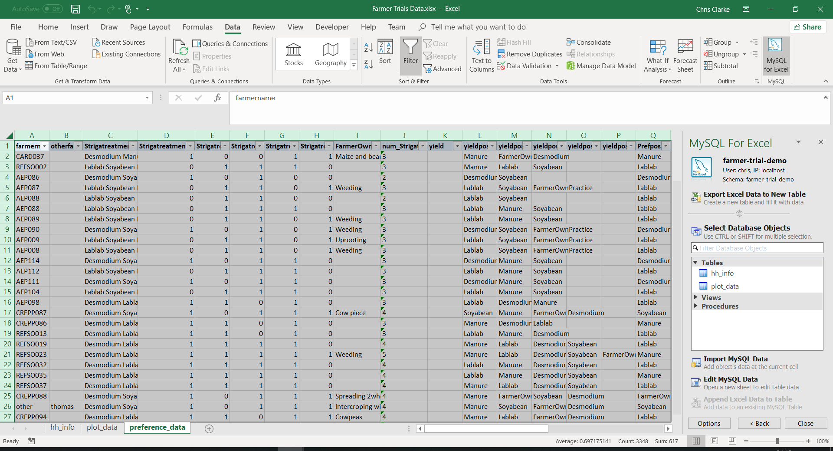

Slide 17
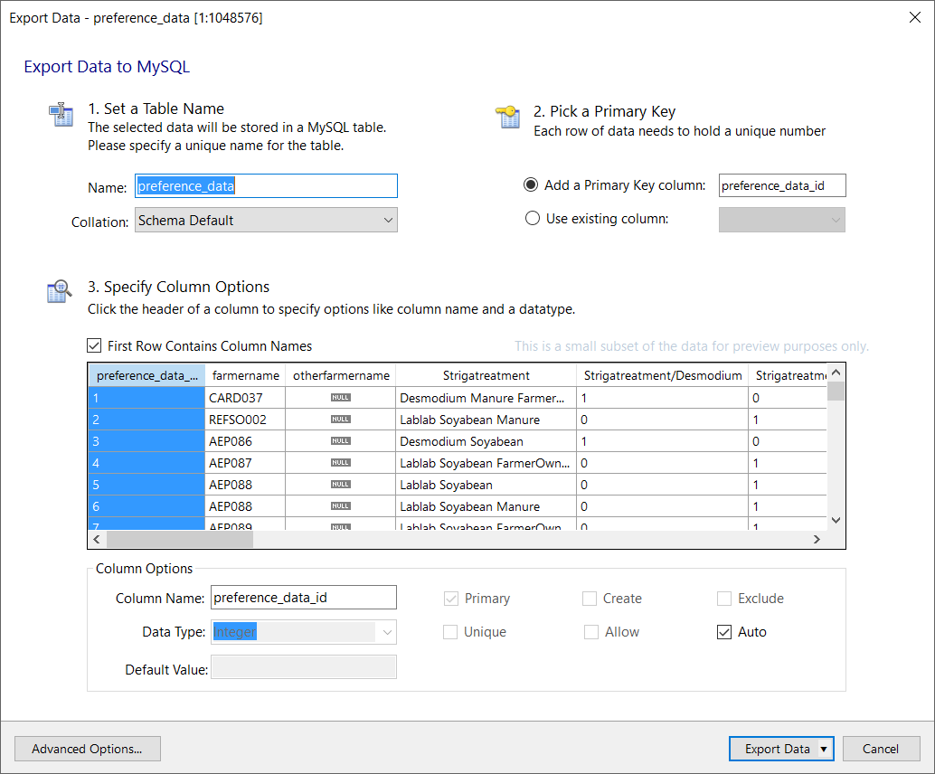

Slide 18
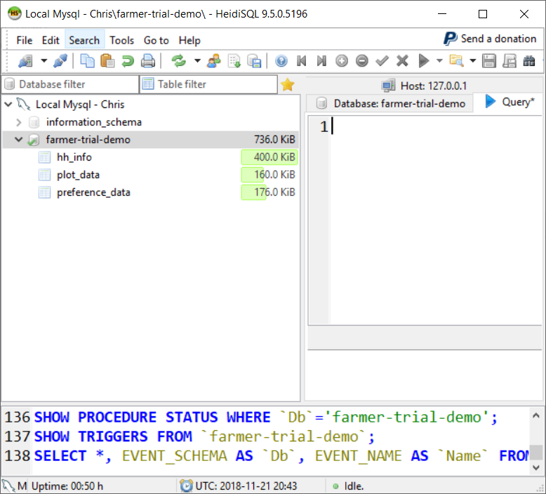
You should see a list of the imported tables here If they do not show you might need to press the refresh button

Slide 19
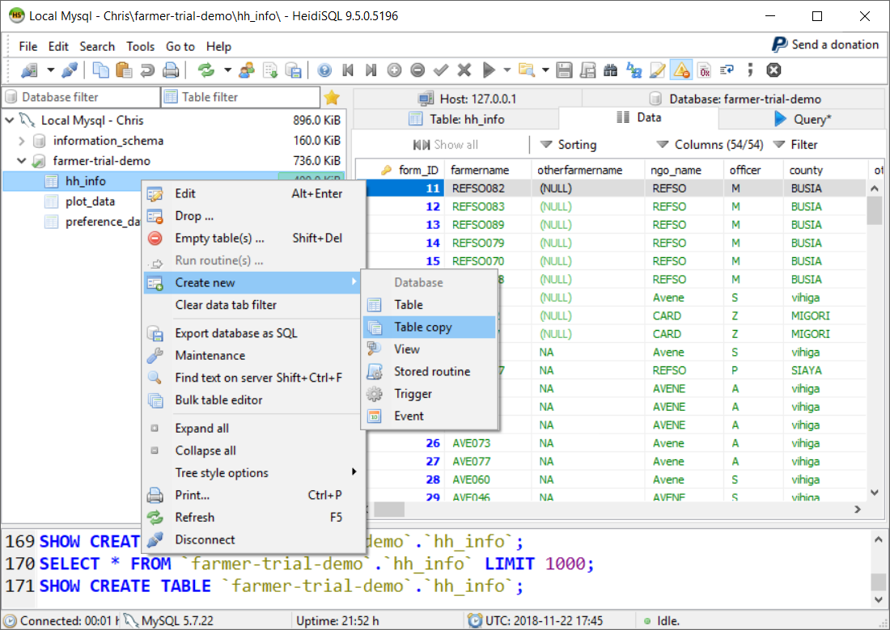
Right-click on a table to see the options menu
We want to create a new copy of the table

Slide 20
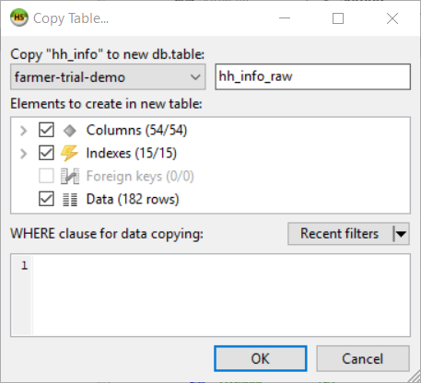
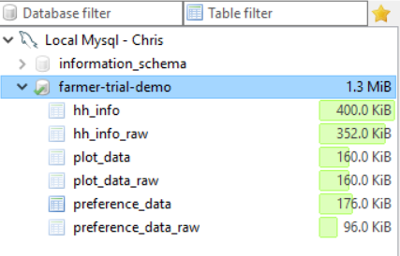
We have change the name to end ‘_raw’ to make it easy to recognise

Slide 21
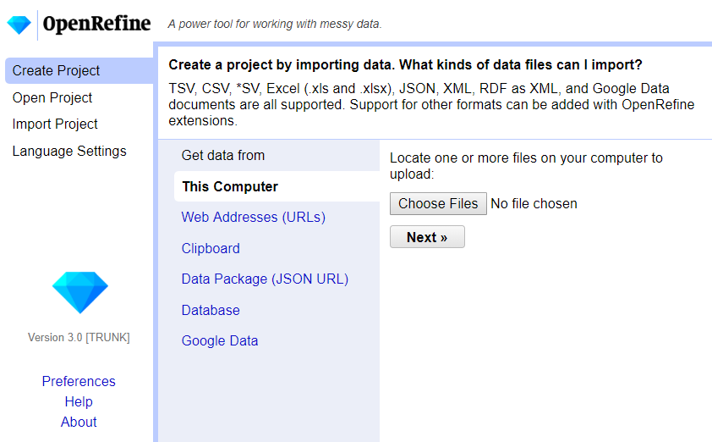
Load the ‘Farmer Trials Data’ excel file from the first step

Slide 22
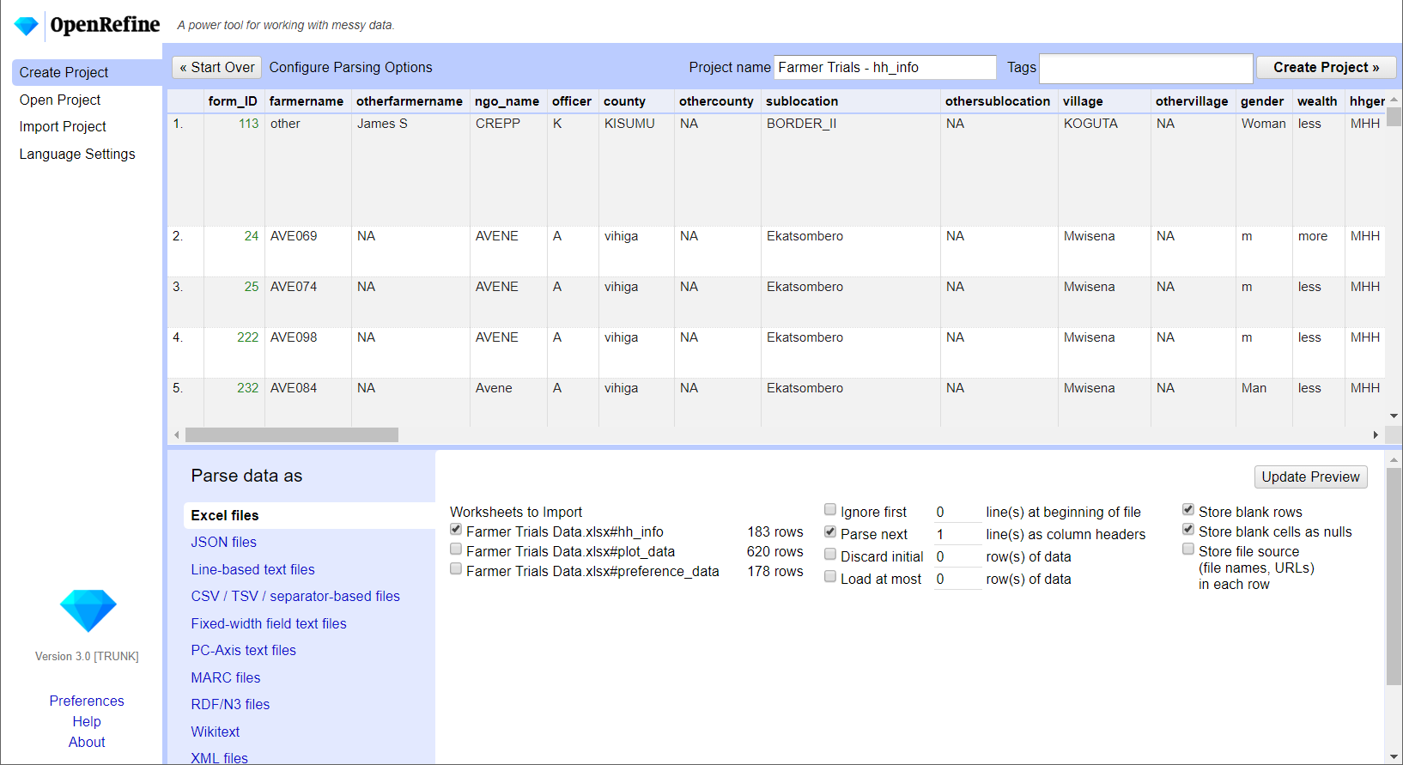
We want to rename the project to reflect the data we are working with
IMPORTANT We can only work with one dataset at a time so untick all of the other worksheets

Slide 23
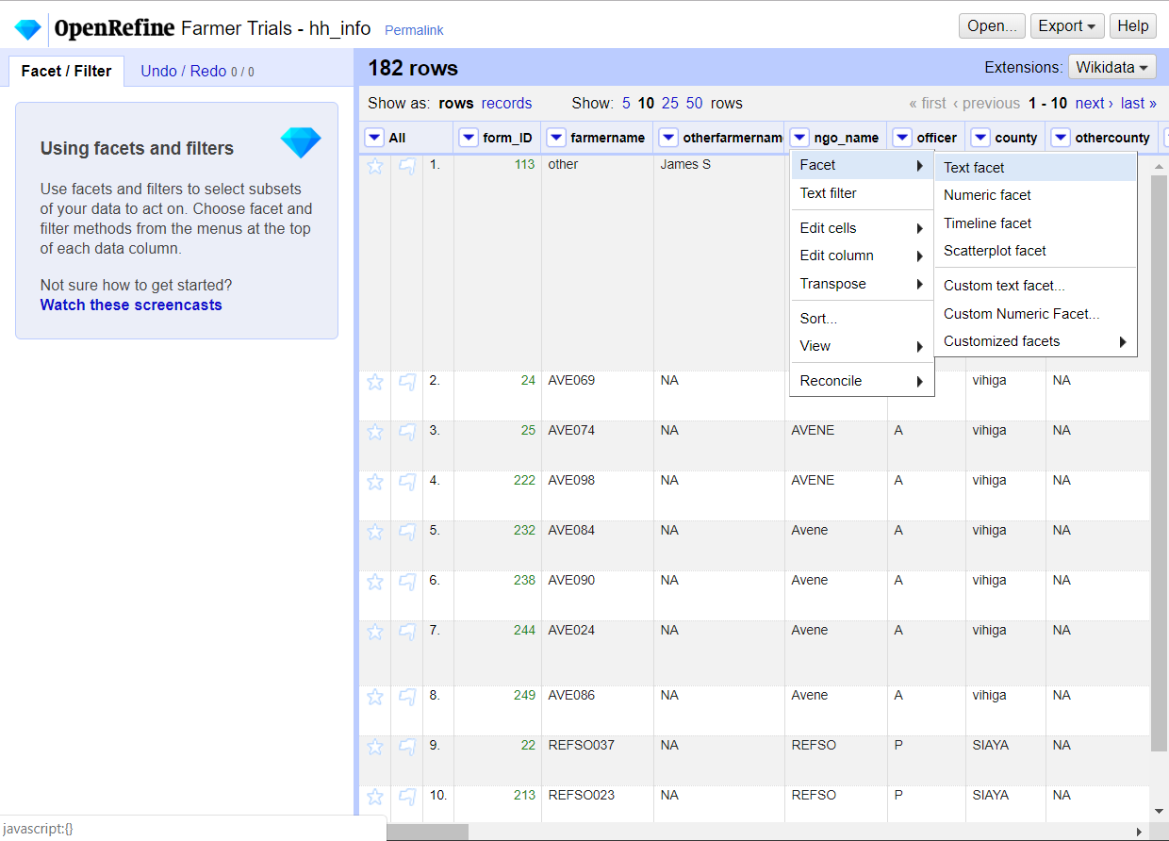
Facets specify the type of data we are expecting

Slide 24
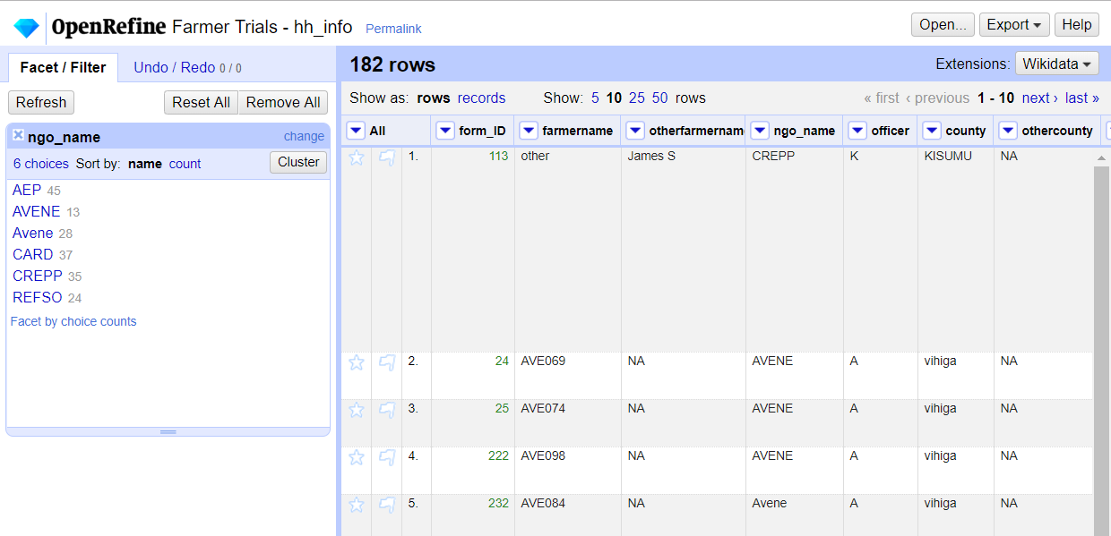
After a facet is selected information about the data in each row is shown
We can see the names of NGOs in our data and how often each entry appeared

Slide 25
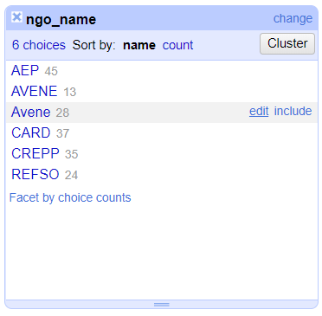
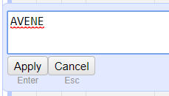
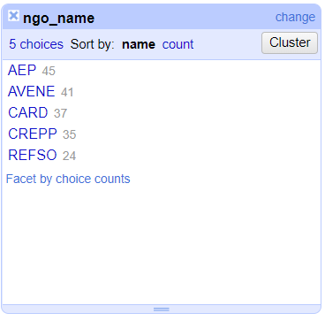
Correct the spelling of ‘Avene’ to match ‘AVENE’
All NGOs now have consistent spelling

Slide 26
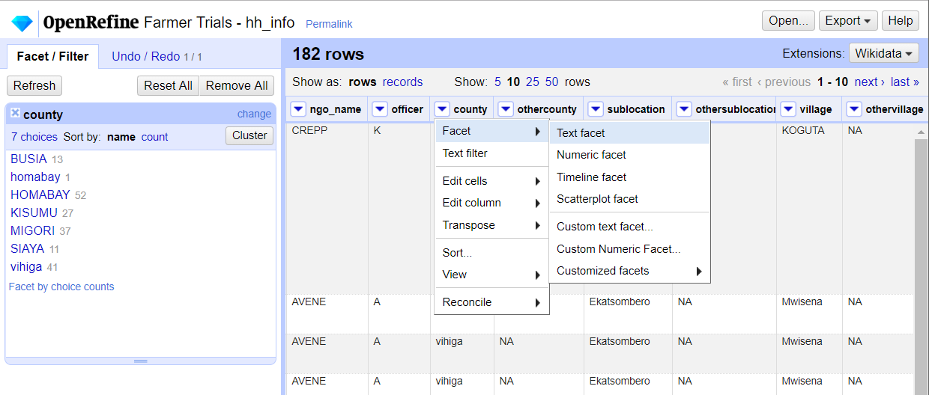
Apply a ‘Text facet’ to see the different values that have been input

Slide 27
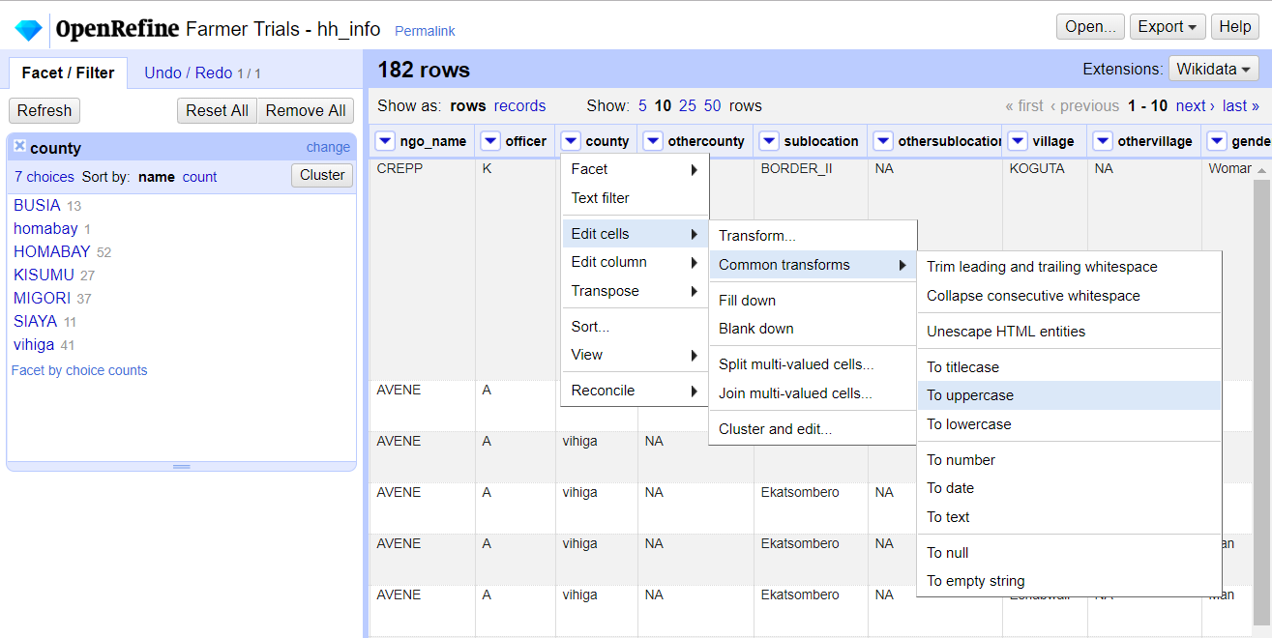
We can see some duplicate names and different formats
We can use the ‘To uppercase’ transformation to convert all text to a consistent format

Slide 28
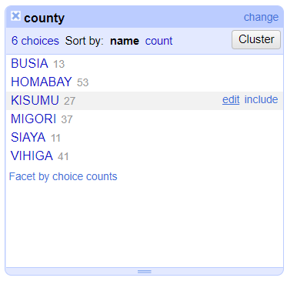
When finished click to close
All counties are now written in upper case

Slide 29
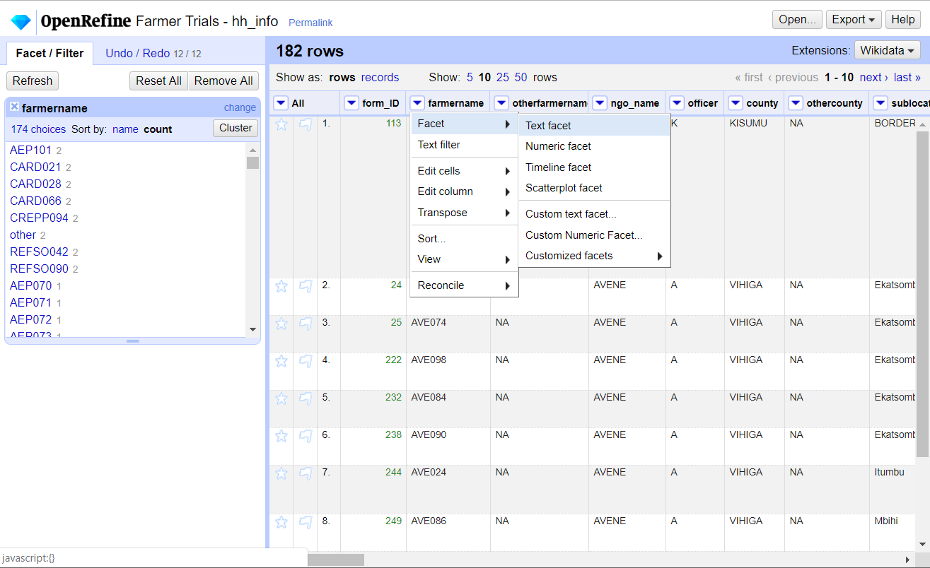

Slide 30
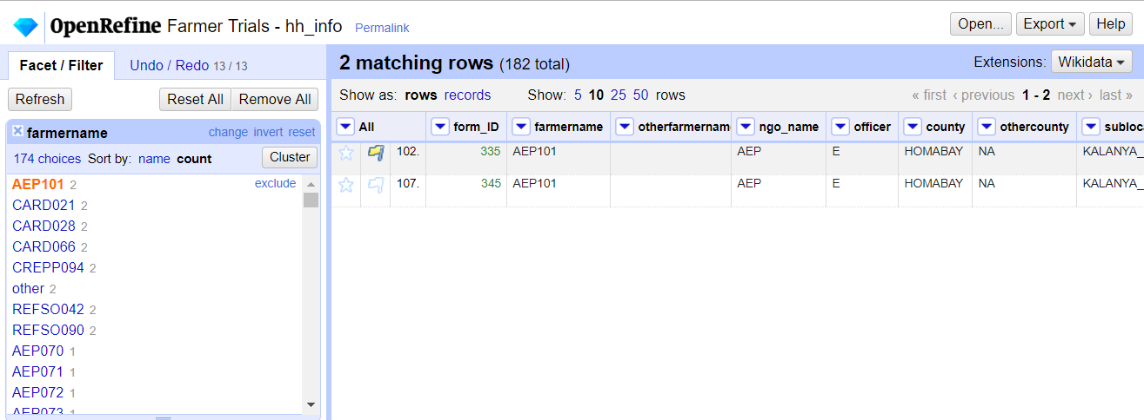
Click on each farmer with multiple records and mark the older row for deletion using a flag

Slide 31
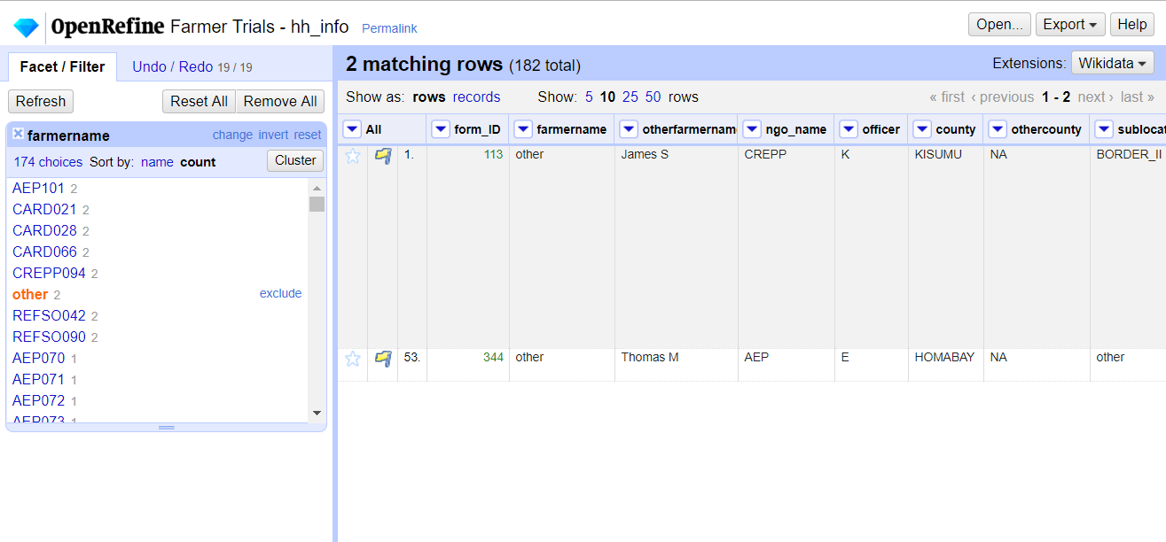
Ideally we would want to try and identify the correct farmername for both of these records. Sometimes this is not possible however, and in this case we have chosen to remove both records

Slide 32
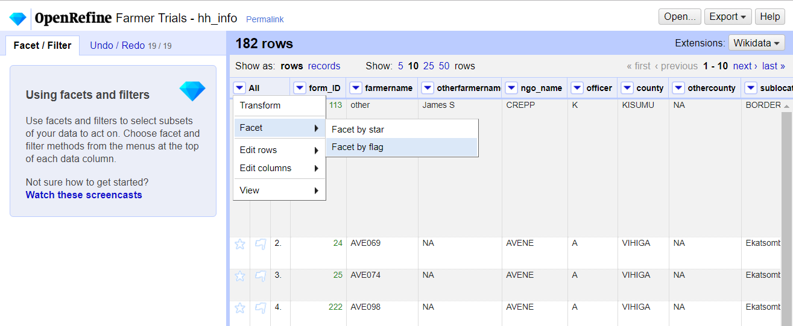
Use the ‘All’ dropdown menu to Facet by flag
Make sure you have closed any other facet panels in this space

Slide 33
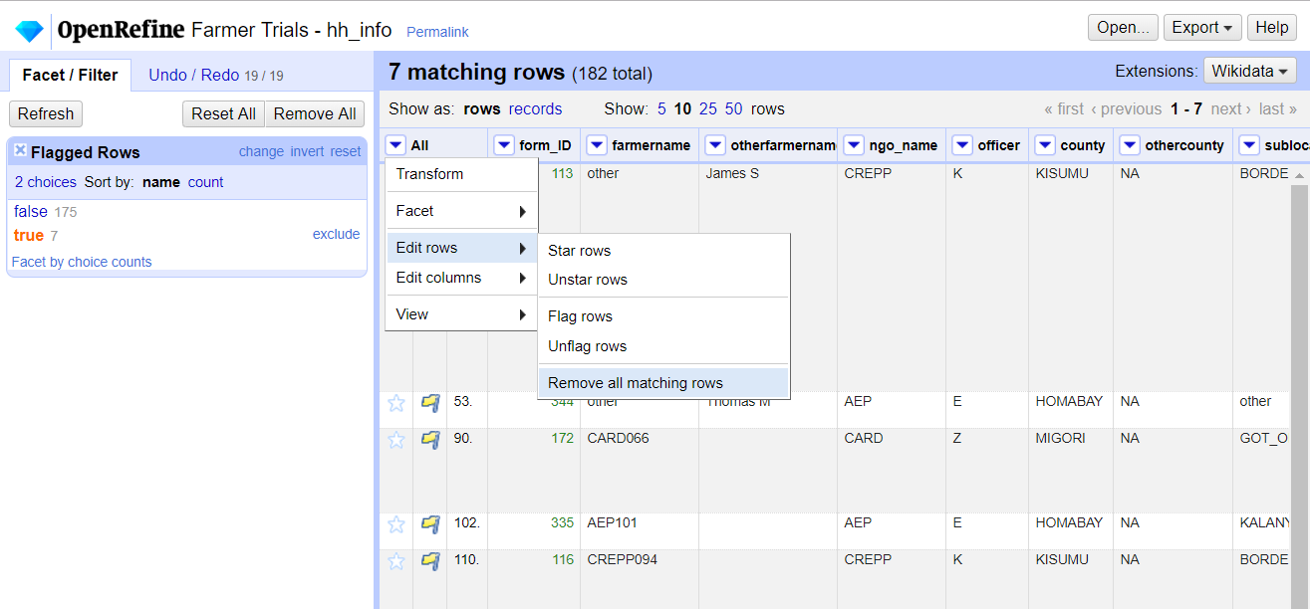
Select the rows that we have marked as ‘true’ with our flag
Then we can remove the rows from our data

Slide 34
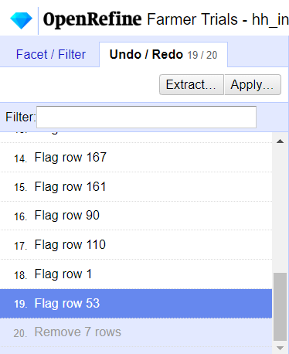
Use the Undo / Redo menu to revert the data back to a previous state

Slide 35

Click ‘Export’ and then ‘Comma-separated value’ to export as a .csv file

Slide 36


Emptying a table will remove all data from it.
It is good to have a backup of the data before doing this

Slide 37

Locate the file that was downloaded from OpenRefine
If we did not first empty our table we could tick ‘Truncate’ to automatically do it for us
Confirm your data is going into the correct database and table
If we did not first empty our table we could also use these options to handle duplicates

Slide 38

You may receive an error message.
If it says import failed then something went wrong.
If it says that there were warnings this is usually fine, and is likely due to some small inconsistencies in the data.

Slide 39

Your cleaned data should now appear in the main data tab if you click ‘refresh’

